Slide 1
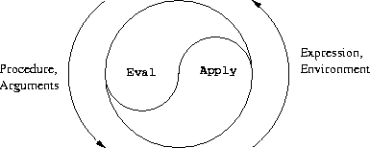
Computational Thinking & Systems Design Lecture 9: Application Programming
Ben Koo
November 9, 2020

Slide 2

Abstract Specification
Logic Model
Logic Model
Concrete Implementation
Context: ALU and Memory Chips are available for composition
Goal: Create Hack Computer
Criteria:
Turing Complete
Run Jack OS
Pass tests
Output: A HDL program that specifies a functional Hack Machine
Process: Compose existing chips
Input:
Chips built in previous weeks
Guiding instructions of Hack Arch.
Course related reference material
A well-defined set of Actions and iterative Branching Strategies
A Roadmap of composable activities
Sequencing and timing conditions
Explicitly state dependencies and resource requirements
Boundary Conditions: Familiarity with HDL, PC, ALU, Memory, and Hack Assembly Language

Slide 3
Abstract Specification 2
Logic Model
Logic Model 2
Concrete Implementation 2
Context: Many competing architectures available
Goal: Classify and unify architectural properties
Criteria:
Generically fulfill computing req.
Compliant with CAP Theorem
Relate to existing products/services
Output: A classification map for architectural types
Process: Calming through available solutions
Input:
Expected application requirements
Definition of computing architecture
Industry news and solution profiles
A well-defined set of Actions and iterative Branching Strategies
A Roadmap of composable activities
Sequencing and timing conditions
Explicitly state dependencies and resource requirements
Boundary Conditions: Only consider known technologies and industrial practices

Slide 4
Prelude
Architecture: invariant properties of a system
Paradox: In contrast to invariance, computing is all about processing variables
Therefore: Computing Architectures must serve certain classes of computing functions within a stable range of operating boundaries
Reasoning about architectural classifications establishes a scientific discipline/language to conduct system designs
CAP Theorem: Consistency, Availability, Partition Tolerance
Architectural metrics is about space, time and energy tradeoffs

Slide 5
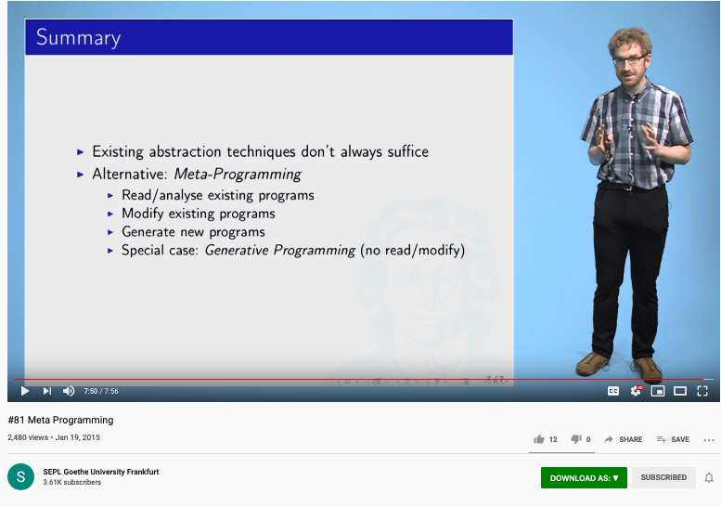
Meta Programming according to Reichenbach

Slide 6
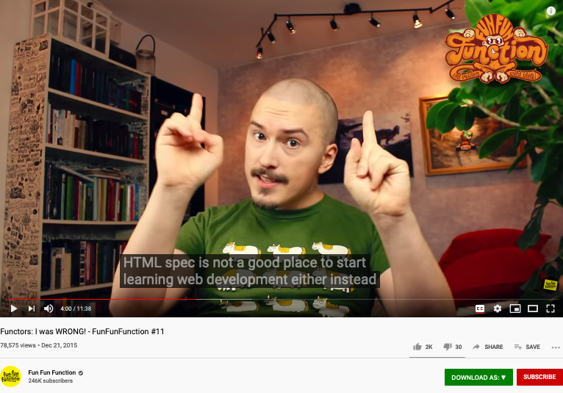
A cool video on Functors
https://youtu.be/DisD9ftUyCk?t=240

Slide 7
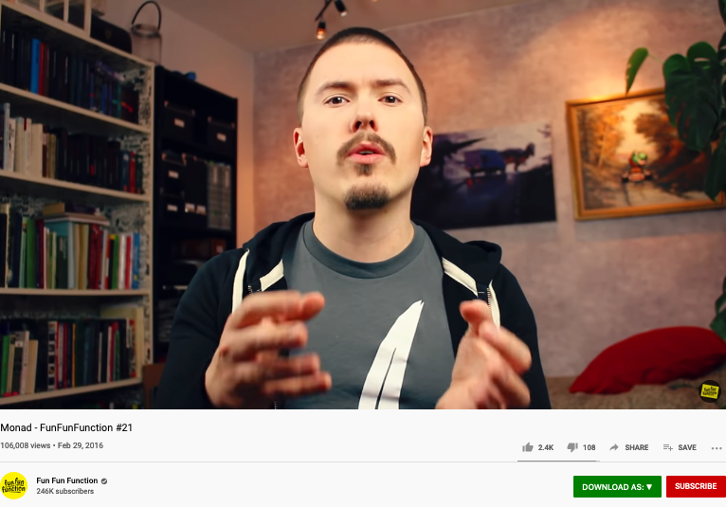
A cool video on Monad
https://youtu.be/9QveBbn7t_c

Slide 8
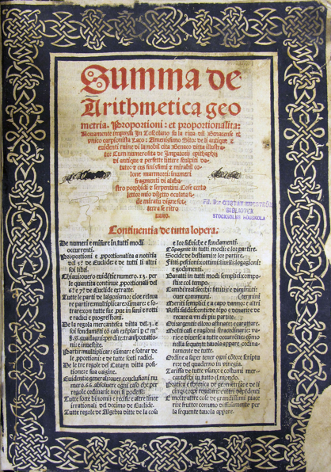
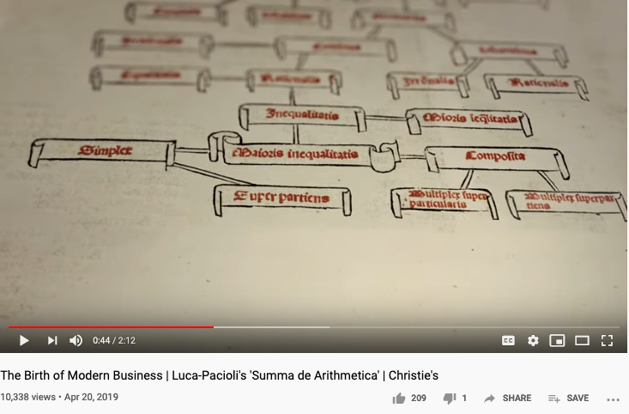
Architectural Analysis has its roots in Math
How computation could work is grounded in arthmetics, geometry, and proportionality…
Youtube video link

Slide 9
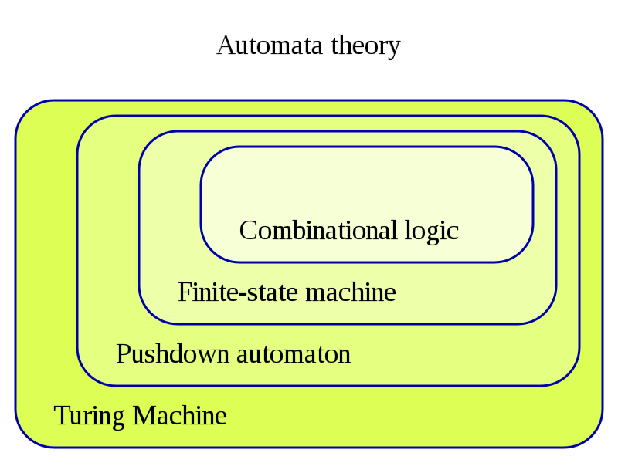
The Hierarchy of Complexity
Image Source: https://en.wikipedia.org/wiki/Turing_machine

Slide 10
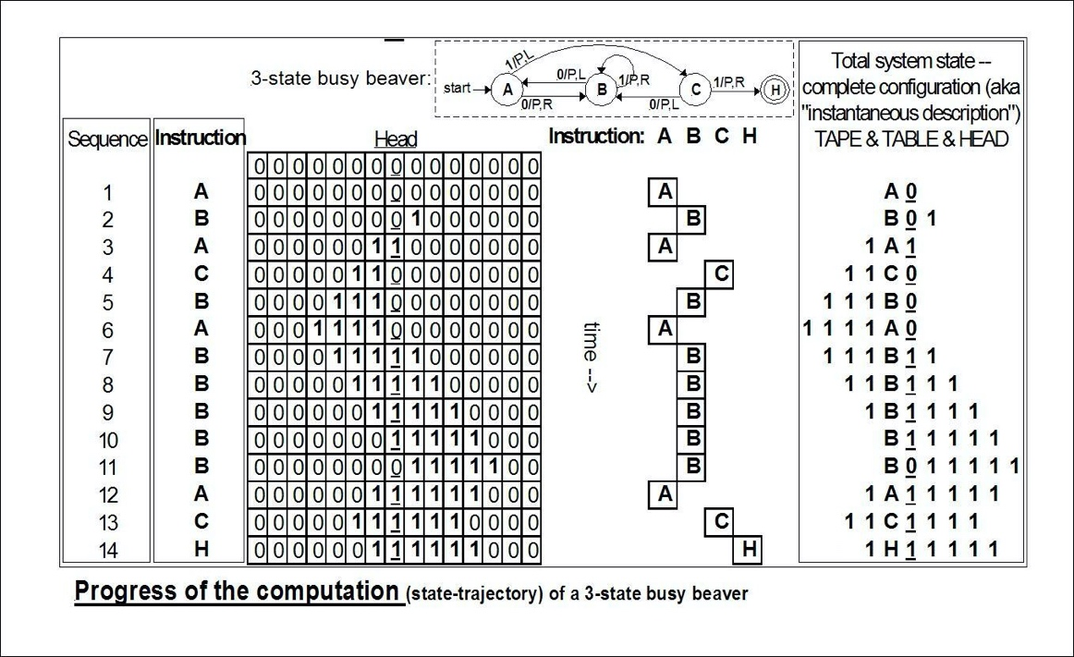
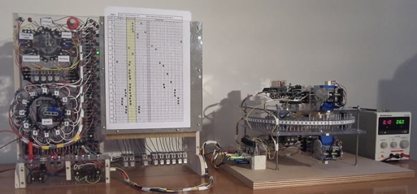
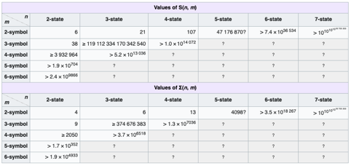

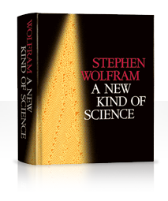
An example of Automaton
The state bounds of
busy beaver
(according to Wikipedia)
Image Source: https://en.wikipedia.org/wiki/Turing_machine

Slide 11
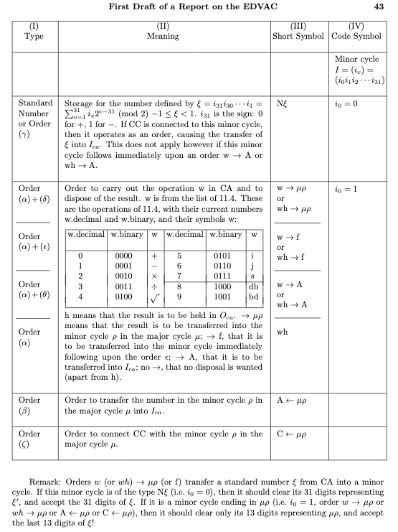
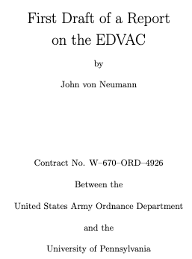
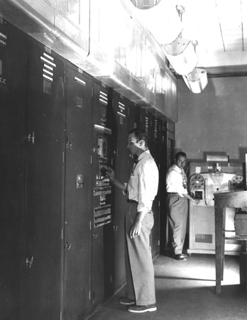
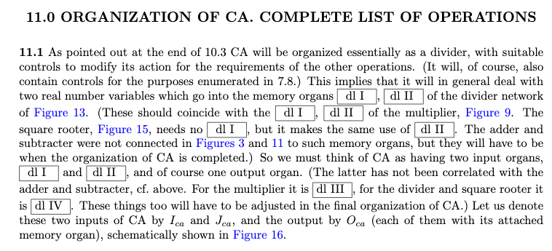
The Notion of Universal Component/Instruction
ENIAC inventors John Mauchly and J. Presper Eckert proposed the EDVAC's construction in August 1944.
Creating a complete set of
Arithmetic instruction is the foundation of computing.

Slide 12
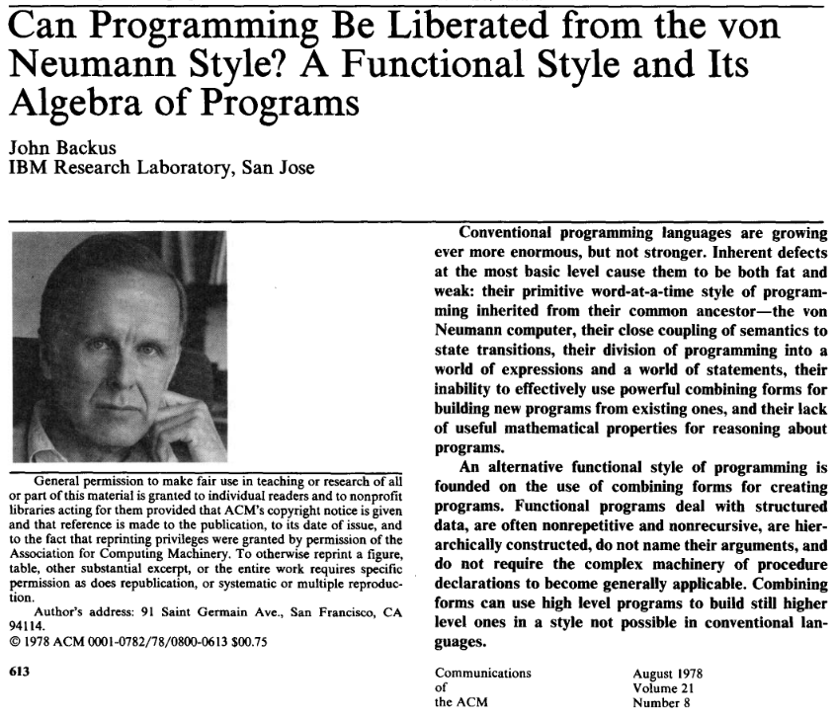

Look beyond von Neumann

Slide 13
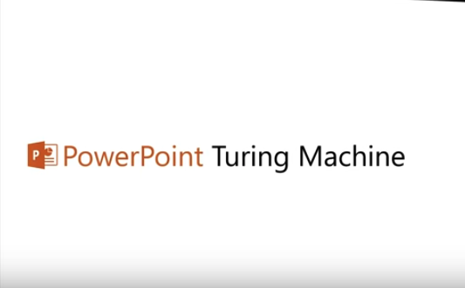
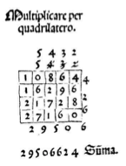
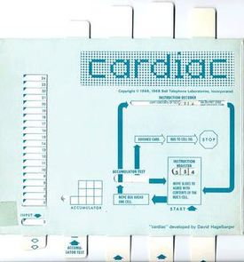
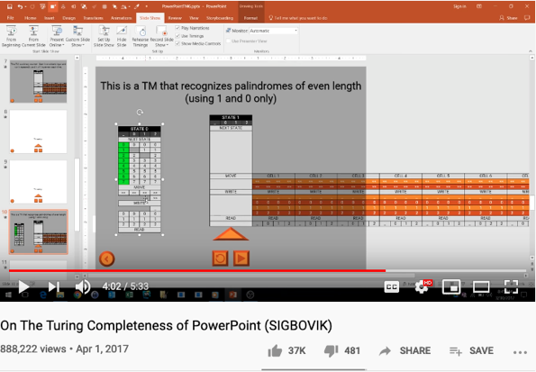
Computational Operations on Paper
https://youtu.be/uNjxe8ShM-8
A way to perform multiplication using matrix layout in Pacioli’s book.

Slide 14
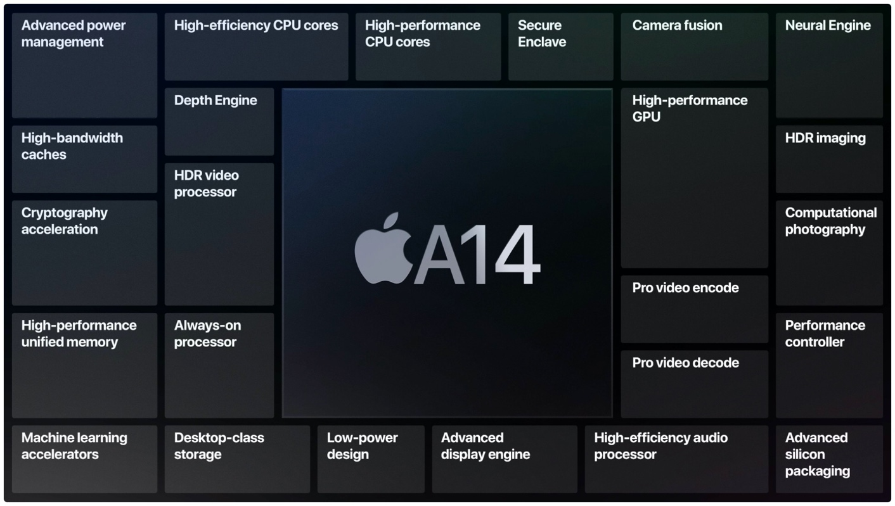
Hybrid Architecture Example
Von Neumann Architecture
Neural Network
Graphics Processing
Dedicated Security
Image Processing
Machine Learning

Slide 15
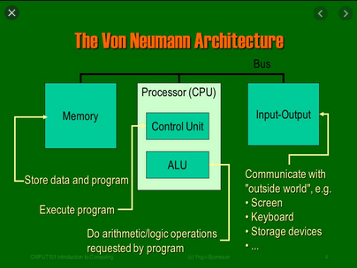
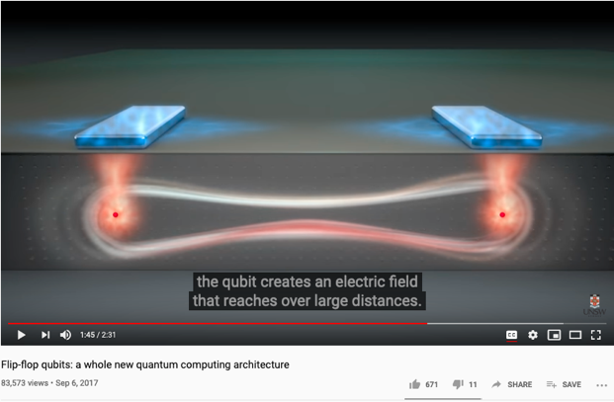
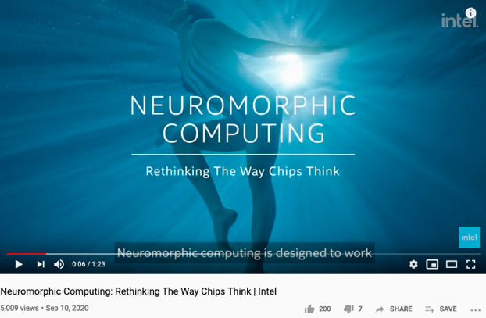
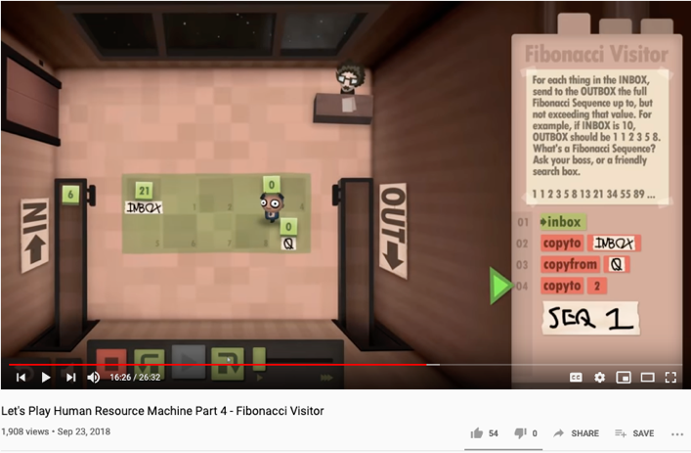
Computer Architectures
Quantum Computing
Architecture
Human Computing
Architecture
Please refer to Agent-based Computing
i.e. NetLogo
Please refer to Captcha
https://www.wikiwand.com/en/CAPTCHA
Notes:
15

Slide 16

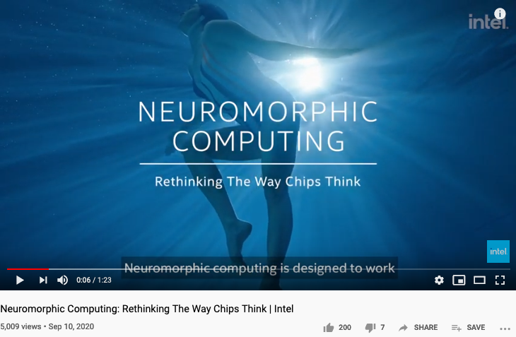
Computing and Spacetime
如果我不运行计算机，或者说让计算机待机，那么电脑就会处于一种类似于休息的状态。其实这么说也没错，但实际上还是有点不一样的。计算机实际上每时每刻都在执行命令，ALU从不停止。ALU每个时钟周期都在干活，输出结果，状态位，PC一直在产一条指令的地址。我们所认为的计算机待机，其实只是电脑在空循环。这个说法也有对的地方。因为空循环的能耗确实小于使用中。空循环时除了最基本的CPU供电以外，需要隔一定时间去刷新主存防止因漏电导致数据丢失。
Oct 2020 郑吉源
Notes:
16

Slide 17
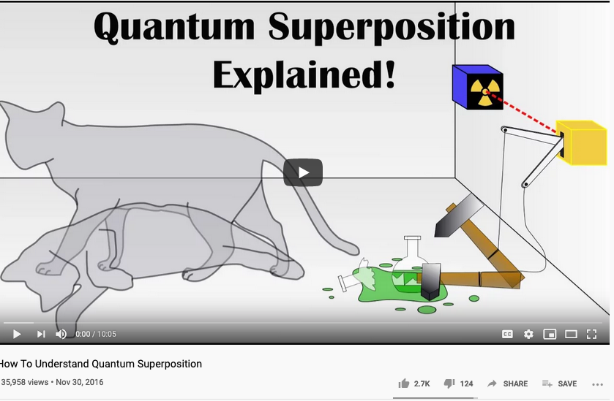
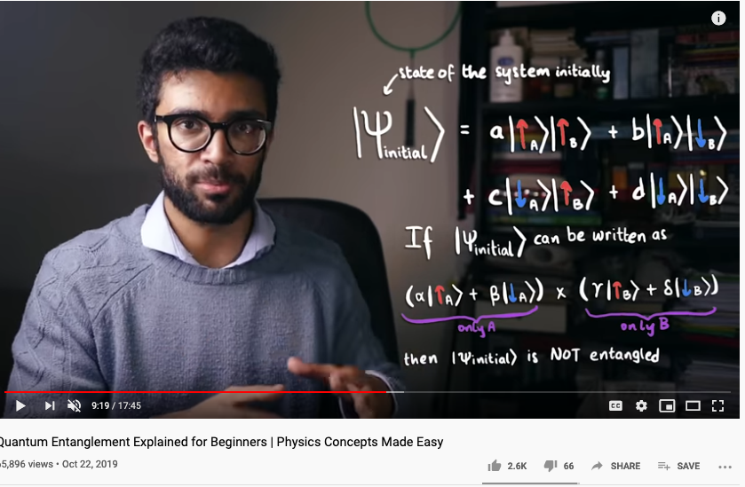
Quantum Terminology
Superposition compresses time
Entanglement collapses space
Notes:
17

Slide 18
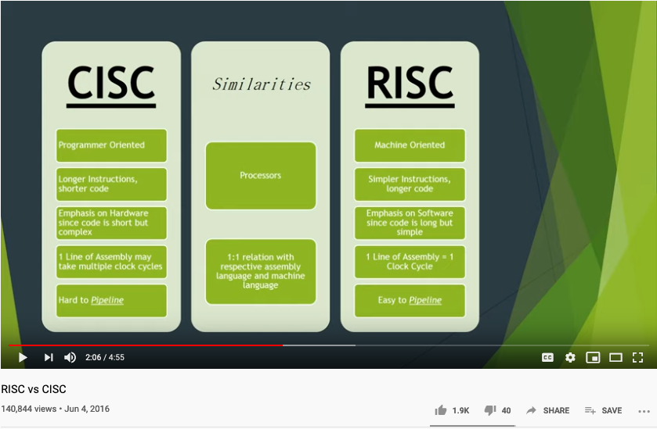
CISC versus RISC Instruction Sets
Notes:
18

Slide 19
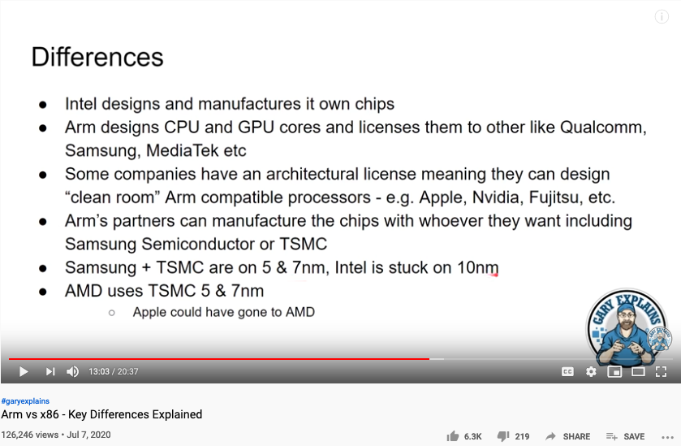
ARM versus Intel Instruction Sets
Notes:
19

Slide 20

History of CPU Development

Slide 21
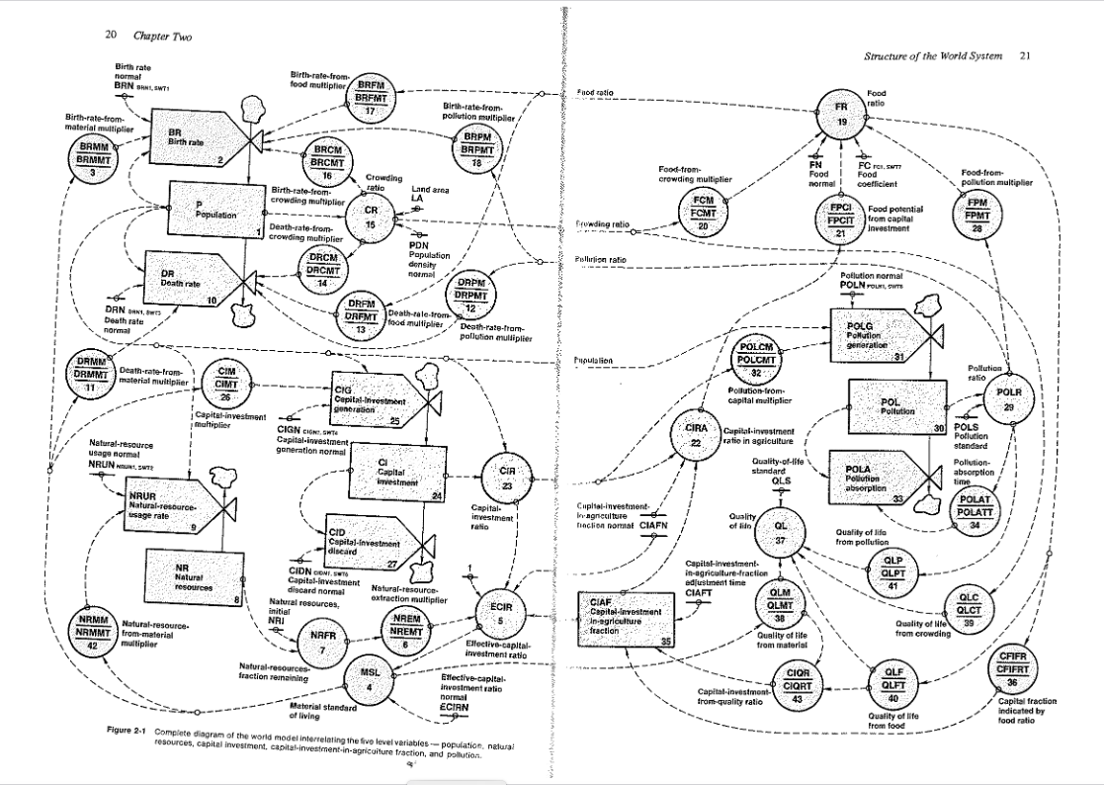
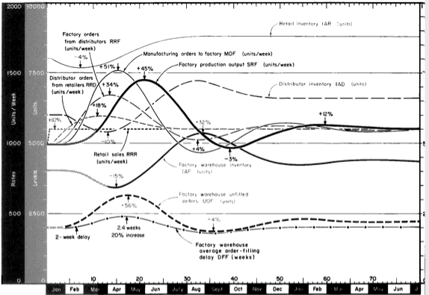
Industrial and World Dynamics
The World is made of three kinds of things:
Stock, Flow, and State variables parameterized in time

Slide 22
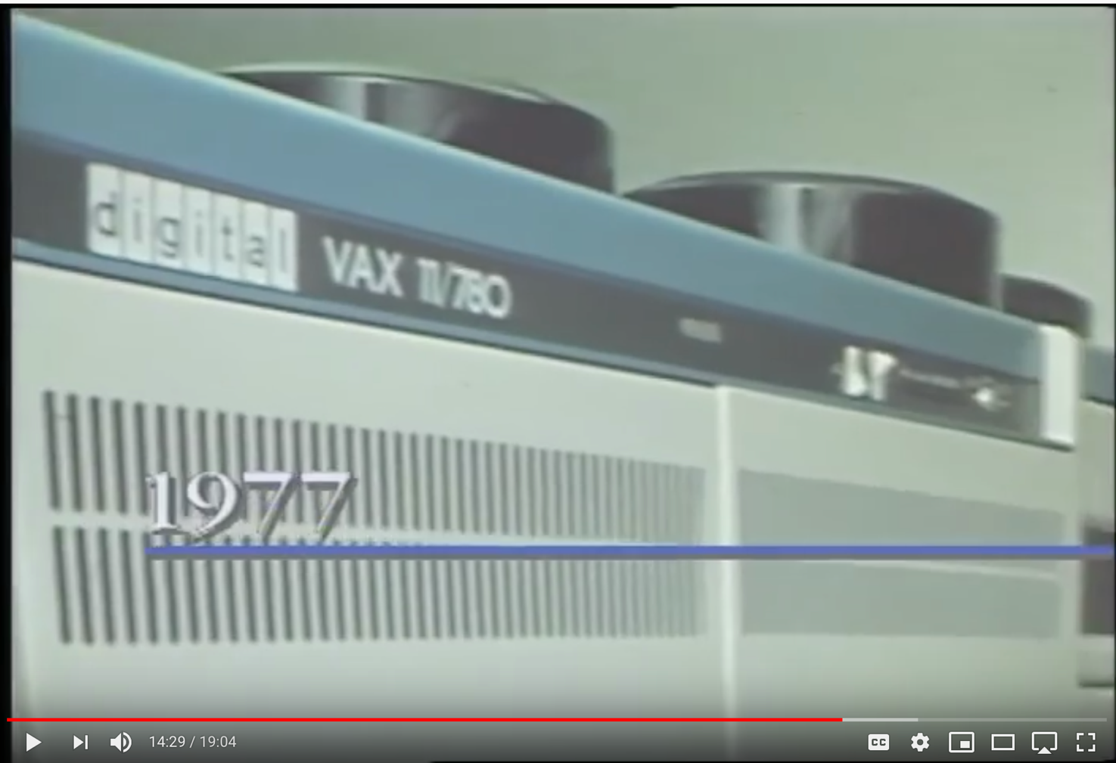
The Vax 11/780 Computer

Slide 23
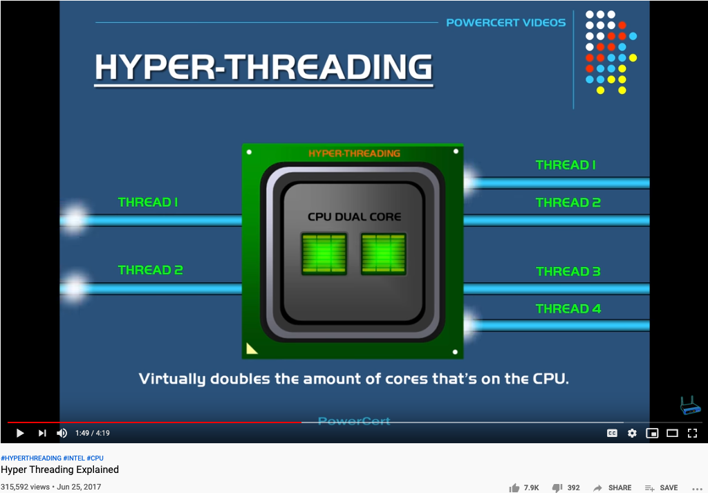
What is Hyper-threading?

Slide 24
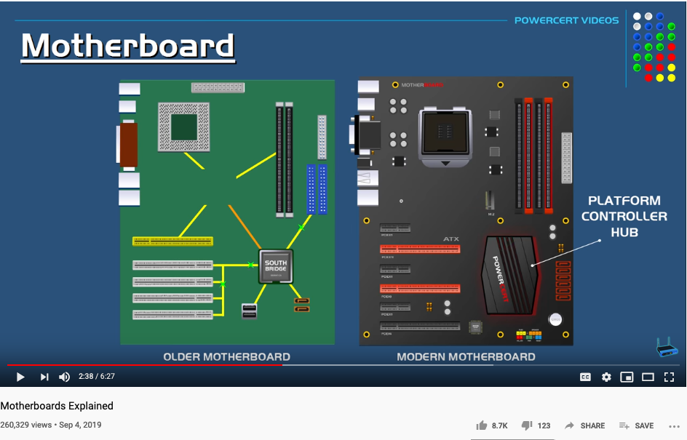
What is a Mother Board?

Slide 25
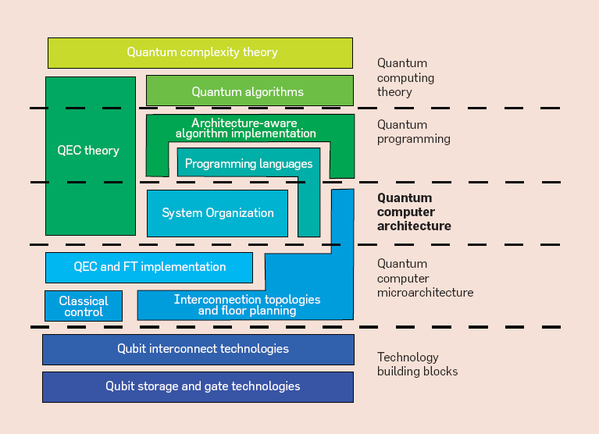
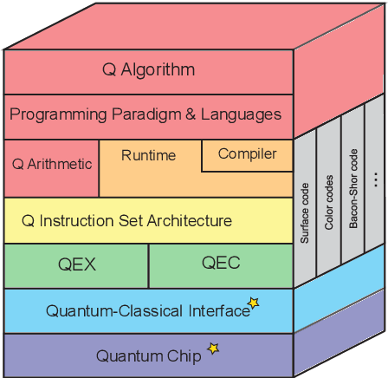
Quantum Computing Architecture
Stack Exchange: How a Quantum Computer can be programmed?

Slide 26
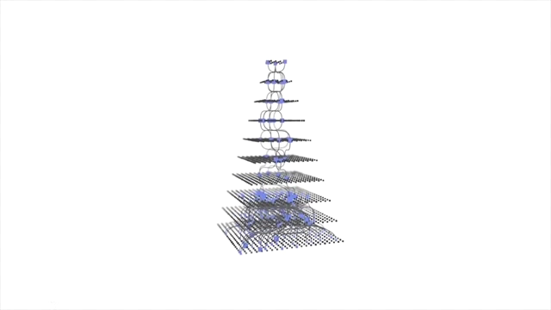
Automated Learning to Learn is here!
Google CEO on Automated Machine Learning

Slide 27


The Master Algorithm that will rule the world?
Bill Gates recommended this book
in 2016 Code Conference
President Xi’s
Bookshelf
The thesis:
Processing data through a single universal learning algorithm— can get all the knowledge from the past, the present, and the future
Pedro Domingos, TMA, P. 25
Chinese Translation
27

Slide 28
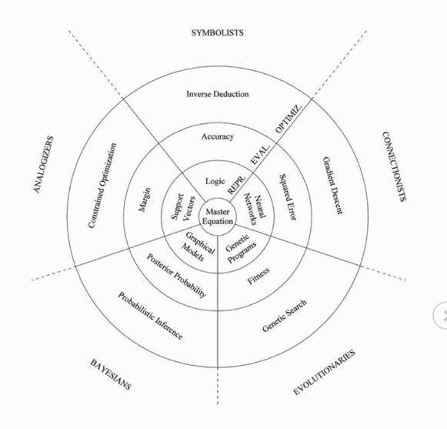
The Five Flavors of Master Algorithm
Image Source: Master Algorithm

Slide 29

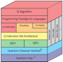











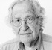

An integrated (ethical) architecture
to implement the Master Algorithm
Software
Hardware
Scientific Revolution
Neutral Network
Symbolic Logic
Causal Probability
Cognitive Semantics
T. Kuhn
Content
IoT and Quantum Computing
TPU
GPU
CPU
Big Data
Computed Data
Artificial Data
Thinking
Standard
J. Hinton
Distributed
Centralized
General Protocol
S. Wolfram
Extreme Learning Process
J. Pearl
Governance Strategies
Collective learning systems
Data Assets, Structures
N. Chomsky
Computing Architectures, Instrumentation
Encoding strategy, Ontology, Epistemology

Slide 30
The 3 Generalized Computing Tasks
and how AI relates to them
Capability | AI inspired threats | Solution to AI threats
Search | Digesting overwhelming amount of knowledge | Apply search to private knowledge
Optimize | Solve problems assumed to be impossible | Become aware when impossible become possible
Simulate | Offer future plans at rates much higher than traditional wisdom | Update inadequate possibility model of our surroundings

Slide 31
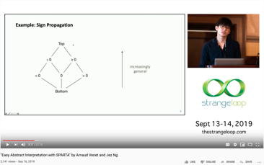
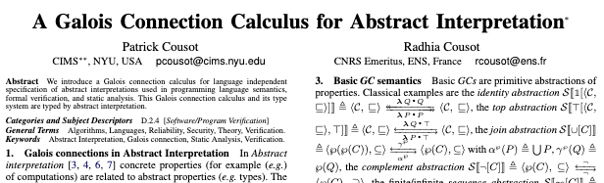
Approximate Truth through Multiple Abstractions
Look into Abstract Interpretation by Patrick and Radhia Cousot
The invention of Widening and Narrowing Operators
Known in the area known as Static Analysis

Slide 32

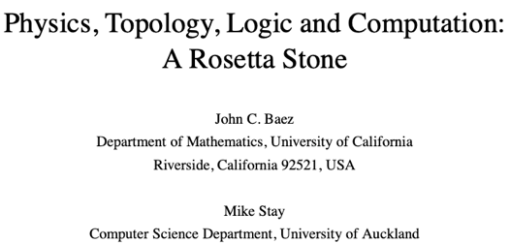
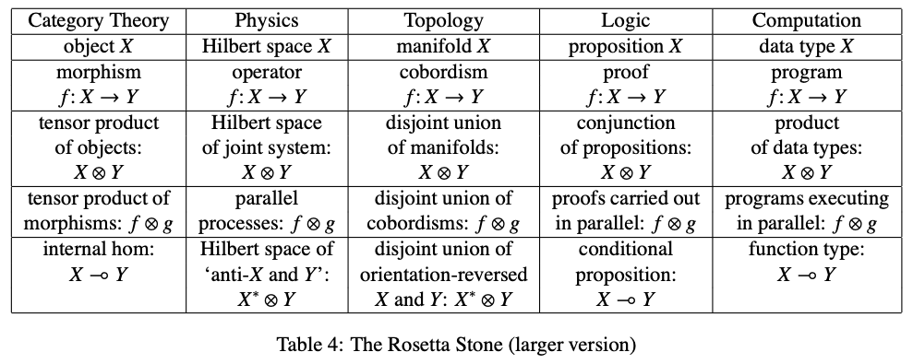
The Rosetta Stone by John Baez
Image source: wikipedia

Slide 33
The Rosetta Stone of Scientific Languages
Biology | Math | Physics | Cybernetics/System Sciences
Homeostasis/DNA | Iterative/Recursive Functions | Multi-Scale Interactions | Feedback Loops
Cellular Construction/Boundary Setting | Difference/Differentiation | Observations | Data Collection
Lifespan Expansion | Integration | Spacetime Accumulation | Statistical Interpretation
Entropy Negation | Numbers/Generative Name Spaces/Algebras | “Unified” Theory | From Theory to Applications and Back

Slide 34
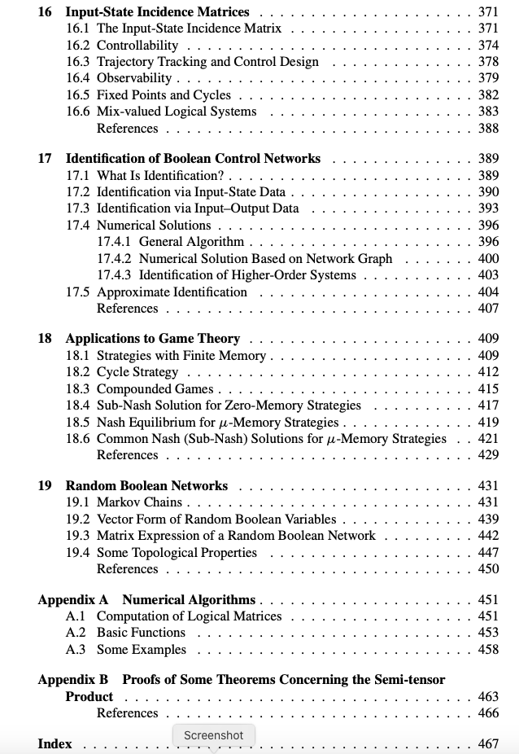
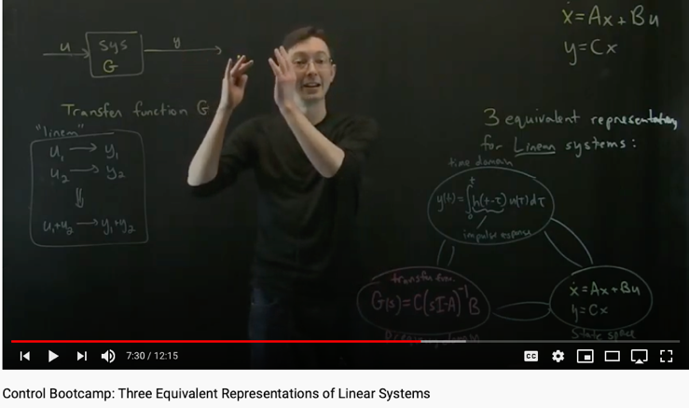

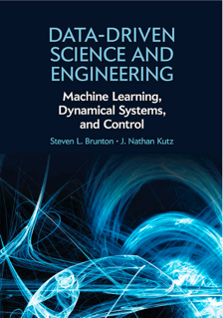
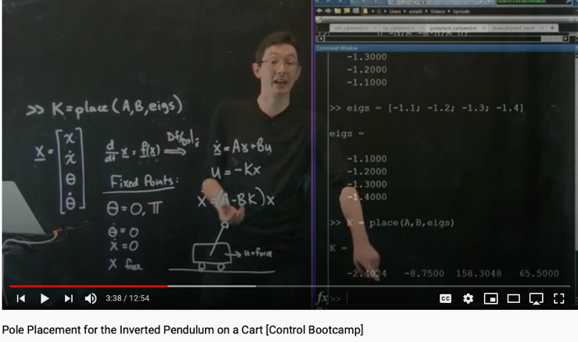
A mathematical Language for
Real Applications that are computationally intensive

Slide 35
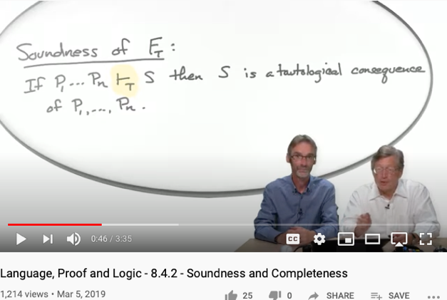

Soundness
Completeness
Every provable statement is true
Every true statement is provable
Cited from : Soundness and Completeness: With Precision on news.ycombinator.com
https://youtu.be/3hspKYIn5ds?t=29
https://youtu.be/3hspKYIn5ds?t=162

Slide 36
Soundness
Completeness
Can we come up with a sound and complete computing architecture classification scheme?

Slide 37
Classifying Architecture based on Spacetime properties
Abstract Specification
Cloud Computing
Deterministic
Probabilistic
Centralized
Hybrid
Distributed
Single/Multi Core
Many Core
Single Site
Multi Site
Many Site
Notes:
37

Slide 38
Processing logic: fetch-execute cycle
Executing the current instruction involves one or more of the following micro-tasks:
Have the ALU compute some function out = f (register values)
Write the ALU output to selected registers
As a side-effect of this computation, figure out which instruction to fetch and execute next.

Slide 39


Computer-on-a-chip interface

Slide 40
Computer-on-a-chip implementation
CHIP Computer {
IN reset;
PARTS:
// implementation missing
}
Implementation: Simple, the chip-parts do all the hard work.

Slide 41
The Hack computer
A 16-bit Von Neumann platform
The instruction memory and the data memory are physically separate
Screen: 512 rows by 256 columns, black and white
Keyboard: standard
Designed to execute programs written in the Hack machine language
Can be easily built from the chip-set that we built so far in the course
Main parts of the Hack computer:
Instruction memory (ROM)
Memory (RAM):
Data memory
Screen (memory map)
Keyboard (memory map)
CPU
Computer (the logic that holds everything together).

Slide 42
Main Parts of the Hack Computer
Instruction memory (ROM)
Memory (RAM):
Data memory
Screen (memory map)
Keyboard (memory map)
CPU
Computer (the logic that holds everything together).

Slide 43
Data memory
load
Low-level (hardware) read/write logic:
To read RAM[k]: set address to k, probe out
To write RAM[k]=x: set address to k, set in to x, set load to 1, run the clock
High-level (OS) read/write logic:
To read RAM[k]: use the OS command out = peek(k)
To write RAM[k]=x: use the OS command poke(k,x)
peek and poke are OS commands whose implementation should effect the same behavior as the low-level commands
More about peek and poke this later in the course, when we’ll write the OS.

Slide 44

Screen
The bit contents of the Screen chip is called the “screen memory map”
Simulated screen:
The simulated 256 by 512 B&W screen
The Screen chip has a basic RAM chip functionality:
read logic: out = Screen[address]
write logic: if load then Screen[address] = in
Side effect:
Continuously refreshes a 256 by 512 black-and-white screen device
When loaded into the hardware simulator, the built-in Screen.hdl chip opens up a screen window; the simulator then refreshes this window from the screen memory map several times each second.

Slide 45
Screen memory map
In the Hack platform, the screen is implemented as an 8K 16-bit RAM chip.
How to set the (row,col) pixel of the screen to black or to white:
Low-level (machine language): Set the col%16 bit of the word found at Screen[row*32+col/16] to 1 or to 0 (col/16 is integer division)
High-level: Use the OS command drawPixel(row,col)
(effects the same operation, discussed later in the course, when we’ll write the OS).
Notes:
45

Slide 46

Keyboard
Simulated keyboard:
Keyboard chip: a single 16-bit register
Input: scan-code (16-bit value) of the currently pressed key, or 0 if no key is pressed
Output: same
The simulated keyboard enabler button
The keyboard is implemented as a built-in Keyboard.hdl chip. When this java chip is loaded into the simulator, it connects to the regular keyboard and pipes the scan-code of the currently pressed key to the keyboard memory map.
Special keys:
How to read the keyboard:
Low-level (hardware): probe the contents of the Keyboard chip
High-level: use the OS command keyPressed()
(effects the same operation, discussed later in the course, when we’ll write the OS).

Slide 47
Memory: conceptual / programmer’s view
Memory
Data
Screen memory map
Screen
Keyboard map
Using the memory:
To record or recall values (e.g. variables, objects, arrays), use the first 16K words of the memory
To write to the screen (or read the screen), use the next 8K words of the memory
To read which key is currently pressed, use the next word of the memory.
Keyboard
Notes:
47

Slide 48
Memory: physical implementation
load
The Memory chip is essentially a package that integrates the three chip-parts RAM16K, Screen, and Keyboard into a single, contiguous address space.
This packaging effects the programmer’s view of the memory, as well as the necessary I/O side-effects.
Memory
0
in
16
RAM16K
(16K mem. chip)
out
16383
16
address
16384
Screen
(8K mem. chip)
15
24575
Screen
24576
Keyboard
(one register)
Access logic:
Access to any address from 0 to 16,383 results in accessing the RAM16K chip-part
Access to any address from 16,384 to 24,575 results in accessing the Screen chip-part
Access to address 24,576 results in accessing the keyboard chip-part
Access to any other address is invalid.
Keyboard
Notes:
48

Slide 49
CPU
a Hack machine language instruction like M=D+M, stated as a 16-bit value
CPU internal components (invisible in this chip diagram): ALU and 3 registers: A, D, PC
CPU execute logic:
The CPU executes the instruction according to the Hack language specification:
The D and A values, if they appear in the instruction, are read from (or written to) the respective CPU-resident registers
The M value, if there is one in the instruction’s RHS, is read from inM
If the instruction’s LHS includes M, then the ALU output is placed in outM, the value of the CPU-resident A register is placed in addressM, and writeM is asserted.

Slide 50
CPU
a Hack machine language instruction like M=D+M, stated as a 16-bit value
CPU internal components (invisible in this chip diagram): ALU and 3 registers: A, D, PC
CPU fetch logic:
Recall that:
the instruction may include a jump directive (expressed as non-zero jump bits)
the ALU emits two control bits, indicating if the ALU output is zero or less than zero
If reset==0: the CPU uses this information (the jump bits and the ALU control bits) as follows:
If there should be a jump, the PC is set to the value of A; else, PC is set to PC+1
If reset==1: the PC is set to 0. (restarting the computer)
Notes:
50

Slide 51



The C-instruction revisited

Slide 52
CPU implementation
Chip diagram:
Includes most of the CPU’s execution logic
The CPU’s control logic is hinted: each circled “c” represents one or more control bits, taken from the instruction
The “decode” bar does not represent a chip, but rather indicates that the instruction bits are decoded somehow.
Cycle:
Execute
Fetch
Execute logic:
Decode
Execute
Fetch logic:
If there should be a jump, set PC to A else set PC to PC+1
Resetting the computer:
Set reset to 1, then set it to 0.

Slide 53
Perspective: from here to a “real” computer
Caching
More I/O units
Special-purpose processors (I/O, graphics, communications, …)
Multi-core / parallelism
Efficiency
Energy consumption considerations
And more ...

Slide 54

Turing Complete Devices can be rather simple
视频:
Coursera Video website: https://www.coursera.org/learn/build-a-computer
Building an 8-bit Computer :https://eater.net.

Slide 55

See How a CPU Work
Notes:
55

Slide 56














Computing Architectures associated with Tools
Abstract Specification
Cloud Computing
Deterministic
Probabilistic
Centralized
Hybrid
Distributed
Single/Multi Core
Many Core
Single Site
Multi Site
Many Site
Hackerspaces
Super Computing Center
Notes:
56

Slide 57
One more thing…

Slide 58




The Limits of Computation (Reversible?)
it is ideally possible to build sequential circuits with zero internal power dissipation.
MAS.862: The Physics of Information Technology Tuesdays 1:00-4:00 E14-493 Neil Gershenfeld 2016
http://fab.cba.mit.edu/classes/862.16/notes/computation/Fredkin-2002.pdf
https://youtu.be/jv2H9fp9dT8?t=261
://youtu.be/IQZ_bQbxSXk?t=2454

Slide 59

Overview on Reversible Computing
https://youtu.be/rVmZTGeIwnc

Slide 60

A Reversible Computing Architecture?
https://youtu.be/rVmZTGeIwnc?t=448

Slide 61


Lloyd: Future of Laptop Computing
Image Source: Wikipedia

Slide 62

Computer Architecture: A Quantitative Approach
Received Honorable
Professorship at
Tsinghua in 2018
He also set up the
RISC V research lab
@ Tsinghua
Shenzhen Campus
www.nand2tetris.org
Notes:
62

Slide 63


Slide 64

Formulas for Comp. Arch. I

Slide 65

Formulas for Comp. Arch. II

Slide 66

Formulas for Comp. Arch. III

Slide 67

Formulas for Comp. Arch. IV

Slide 68

Summary
Think of computing devices as matrix processing machines
Originated in the principle of symmetry (conservation laws)
Presented in the format of double entry book keeping in 1491 book
Architectures can be defined by language specifications
All vocabulary must be grounded in spacetime-energy metrics
Syntax of languages can be formally analyzed through tools such as K-Framework
Semantics of languages can be analyzed using Abstract Interpretation
Modern computing architecture is mostly hybrid
Mobile and Cloud computing dominate usage and resources
Computing results can be measured in Entropic terms
The accounting practice of energy can be traced back to Hamilton and Pacioli

Slide 69
Questions
Is it possible to shape a meta-language that self-evolves to approximate all computing architectures over time?
Would this language be the Holi grail that leads us to find the Master Algorithm?

Slide 70


Appendix

Slide 71
Computing bottleneck is limited by Data Synchronization (Entanglement)

Slide 72

How Internet Works by Ben Eater

Slide 73
How to conduct counting and abstract counting reliably across spacetime?

Slide 74

A Common Trick in Data Verification
Double Entry Ledger is a mechanism to leverage closure properties to verify data!
Double Entry Book Keeping was used as an example to explain the power of Symmetry/Invariance properties in Mathematics, not the only application
All fields of sciences and maths are grounded on invariance somehow.
“the root of all symmetry principles lies in the assumption that it is impossible to observe certain basic quantities” (p. 178 of Particle Physics and Introduction to Field Theory, New York: Harwood Academic Publishers.)
https://plato.stanford.edu/entries/weyl/

Slide 75


Accountants and the Invention of Writing
Luca Pacioli published 26 pages of account balancing techniques in a math textbook
Accounting Balancing Equation
Asset = Liability + Equity (some times called Capital)

Slide 76

Double Entry Book Keeping is the foundation of Capitalism
1494年头版，1523年再版
复式记账是Pacioli最著名的科学贡献
Pacioli 是达芬奇的合作伙伴
Summa de arithmetica, geometria, proportioni et proportionalita （算术、几何、比例与可比性之总论）
该书集成了代数、几何、逻辑、计算和记账的内容，包括复利计算等金融学的知识。
是现代科学的奠基之作。
“historian James Aho linked double-entry bookkeeping to the ancient art of rhetoric, … medieval merchants used double-entry bookkeeping as a rhetorical tool of capitalist propaganda, to persuade their ‘audience’ that their business was honest, morally sound and its profit-making ethically justified.”
Excerpt From: Jane Gleeson-White. “Double Entry.”
Notes:
“historian James Aho linked double-entry bookkeeping to the ancient art of rhetoric,”
Excerpt From: Jane Gleeson-White. “Double Entry.” Apple Books.

Slide 77

A Timeless Computing Architectural Element
Computation takes place when the total amount of assets is being calculated…
When something is not accounted for, it will never show influence on the total amount of assets…

Slide 78






Double Entry Bookkeeping and Linear Algebra
Notes:
“historian James Aho linked double-entry bookkeeping to the ancient art of rhetoric,”
Excerpt From: Jane Gleeson-White. “Double Entry.” Apple Books.

Slide 79




The Accounting Equation and Hamiltonian Mechanics
Accounting Balance Equation:
Assets = Liability + Equity
The structural similarity may seem to be simple in the beginning. But when put them in iterative procedures…
Notes:
“historian James Aho linked double-entry bookkeeping to the ancient art of rhetoric,”
Excerpt From: Jane Gleeson-White. “Double Entry.” Apple Books.

Slide 80

Hamiltonian Mechanics make energy Accountable
Assets = Liability + Equity
and
H = T + V
These two equations basically dominated two fields: Economics and Physical Sciences
Thinking from a Meta-Mathematical viewpoint,
they present a way to break down the total amount of conservative resources,
and therefore, allows iterative branching and therefore continuous replication.
Notes:
“historian James Aho linked double-entry bookkeeping to the ancient art of rhetoric,”
Excerpt From: Jane Gleeson-White. “Double Entry.” Apple Books.

Slide 81



Hamilton did more work on the Accounting Equation
The aim of this paper is to show how the mathematical basis is used for a precise treatment of double-entry bookkeeping, which was firstly developed in the nineteenth century by Sir William Rowan Hamilton. This is done by using basic notions of matrix algebra with the roots to the idea of using ordered pairs. We also reveal how the complex numbers and the rationals (fractions) developed in a mainstream of accounting science and became a leading platform for the ongoing processes within the Industry 4.0.
Image Source: Research Gate
Notes:
In the presentation on Oct-9, 2020, Ray again, stated a link between the Atomic Explosion’s 20 thousands generations of chain reactions and the layers of Syntatic Trees in Chomsky’s Syntactic Theory about language. Then, he also reminded us that Chomsky and Shannon were working in locations that are 100 feet away from each other. The white and black dots are demonstrating the patterns of Fibonacci series.

Slide 82



Kuhn Cycle: recursion and symmetry-breaking
Keeping namespace consistent
Normal Science
Model
Drift
Model Crisis
Model Revolution
Paradigm
Change
Emerging cases or
systematic attacks
Ouroboros Snake
in five named stages

Slide 83
The second Language Design Strategy
combine structure with operations!
The isomorphism between accounting equation and the Hamiltonian formulation states: Science is about utilizing symmetries/invariance recursively.
Put the Accounting /Hamiltonian equation in a matrix structure, the addition operations becomes iterative.

Slide 84

Concrete Activities in Daily Workflow
What is DevSecOps?
Image courtesy: Paladion Corporation Website Image source: https://www.paladion.net

Slide 85




Main Thesis of today’s lecture: “How do you know that you know?” “Writing Technology” being the a way to help reach consensus?
https://raft.github.io/
https://lamport.azurewebsites.net/pubs/pubs.html

Slide 86





Language Independent Analysis Methods
To ensure universality, one needs to be language/implementation agnostic
https://www.di.ens.fr/~cousot/AI/
Link to a short paper introducing TLA+
Mathematical Abstraction of Temporal Logic
http://www.kframework.org/

Slide 87
A Cognitive Foundation X makes sense in Context Y
Huawei VP Mr. Yang Shaoqing
In a World Y where all things make sense
If you speak the language of X!

Slide 88


Where is Paxos?

Slide 89


Simplicity in NsM is Strategic!
The Named Roles in Paxos/Raft
Proposers to present changes
Learners to Authorize
Learner to Execute
Governance Tools
Holacracy
Hypha-Decentralized Human Organization
Image Source: An Overview of Consensus Algorithms, by DxChain
Image Source: Hypha Project, by Hypha Earth

Slide 90

Paxos Visualized

Slide 91


A Talk on the subject of Paxos

Slide 92

A Talk on the subject of Raft

Slide 93

Kubernetes/ETCD and Raft
Notice that Kubernetes is the original form of Cybernetics.

Slide 94


Namespace Management in Time

Slide 95



The notion of Symmetry/Symmetry-breaking
Find a video or image showing the Trust-worthy Book Keeping comes from Symmetry and Symmetry-Breaking!

Slide 96
How to move data in its simplest possible form?
Huawei VP Mr. Yang Shaoqing
Algorithms is about moving data!

Slide 97

A short introduction video
https://youtu.be/j2m5YMnHvQQ

Slide 98


Connecting Abstract and Concrete Domains
Prof. Cousot and Koo in 2005
What is IMP?
https://slideplayer.com/slide/8506871/

Slide 99


The Basic Working Principle of Composition
https://slideplayer.com/slide/8506871/

Slide 100

Arrow Chasing Computation
https://slideplayer.com/slide/8506871/

Slide 101

Why is Simplicity in NsM so Strategic
Controlled Entropy = Controlled Time
Think about Google’s interface
Why are they removing buttons on iPhone?
Bound Variables in Logics
When complexity is inevitable
Leverage the notion of symmetry
See Hermann Weyl’s quote on lacking information…
Image Source: Intro to System Science and Cybernetics,
Dr Paul Pangaro

Slide 102

Moving Data in Traditional Workflows
https://youtu.be/p7-U1_E_j3w

Slide 103

Data Sychronization with DevOps/CICD
https://youtu.be/p7-U1_E_j3w

Slide 104

Instrumentation of DevOps
Image courtesy: PETSEBAN on NearCoding

Slide 105

Personalized Digital Tools in Software Containers

Slide 106

Become aware of a new asset class
Asset Container | Operations | Tools
File(Document) | Content Editing | MediaWiki
File Directories | Changing File Structures | Git
Micro Services | Execute Programs | Docker
Configuration Data | Deployment & Maintenance | Kubernetes
Physical Environment | Physical Actions | Hackerspaces

Slide 107

Cloud Computing Reference Architecture

Slide 108
Why are Names important?
A generic pool of conceptual handles for computation
Some times it is better to keep all names (terms) neutral
By assigning unique and countable names to a domain, it allows the naming systems to be reused or evolved for future use.
Many of the computing/logical systems are universal
They can be reused by many applications
Logical Systems have been studied extensively, and may possess desirable properties
Soundness and Completeness

Slide 109

Computable Logic and Types of “Birds”

Slide 110


The Names of Birds (Functions)

Slide 111
Associating neutral names to ideas has utility
It is like telling mythological stories and using the names of characters to define concepts and ideas
Assigning names to ideas: using name space to compress algorithmic (temporal) complexity
Each story is a prototypical/idealized context that could be reused across many application areas

Slide 112

Temporal Logic: assign names to Behavioral Properties
TLA+ (Temporal Logic in Action) provides a formal language and automated mechanism to assign names in algorithmically prescribed loopy or recursive structures.

Slide 113

TLA+ can help analyzed Architectural Properties

Slide 114


In DevOps/CICD Jenkins holds the key!
Jenkins enables all system-level actions to be triggered with properly assigned names.

Slide 115

Jenkins actions are managed in the Namespaces of Plug-ins

Slide 116


Hamilton/Lagrangian action formalism can be operationalized!
Jenkins enables all system actions to be triggered with properly assigned names.
Automation provided by Jenkins could be subsumed by the action formalism invented by Lagrange and Hamlilton.

